Slide 1
Tree Data Structure

Slide 2
What is a tree?
A tree consist of nodes connected by edges.
In a picture of a tree the nodes are represented as circles and the edges as lines connecting the circles.
In a tree, the nodes represent the data items and the edges represent the way the nodes are related.
A tree with nodes which has maximum of two children is called a binary tree.
Nodes
Edges

Slide 3
What is root, parent and children in a tree?
The node at the top of the tree is called root.
Any node which has exactly one edge running upwards to other node is called a child
The two children of each node in a binary tree is called left child and right child.
Any node which has one or more lines running downwards to other nodes is called a parent
A node that has no children is called a leaf node or leaf
A
Root
D is the left child of B
B
B is the parent of D and E
C
D
E
F
G
H
E is the right child of B
I
J
leaf

Slide 4
What is path and subtree in a tree
Sequence of nodes from one node to another along the edges is called a path.
Any node which consist of its children and it’s children’s children and so on is called a sub tree
Path
A
B
C
D
E
F
G
H
I
J
A subtree with F as its root

Slide 5
Key value of a node
Each node in a tree stores objects containing information.
Therefore one data item is usually designated as a key value.
The key value is used to search for a item or to perform other operations on it.
eg: person object – social security number
car parts object– part number

Slide 6
Binary Search Tree
Binary Search Tree
is a tree that has at most two children.
a node’s left child must have a key less than its parent and node’s right child must have a key greater than or equal to its parent.

Slide 7
Operations of Binary Search Tree
There are four main operations perform in a binary search tree
Find – find a node with a given key
Insert – insert a new node
Delete – delete a node
Traverse – visit all the nodes

Slide 8
Operations - Find
Find always start at the root.
Compare the key value with the value at root.
If the key value is less, then compare with the value at the left child of root.
If the key value is higher, then compare with the value at the right child of root
Repeat this, until the key value is found or reach to a leaf node.

Slide 9
Find value 57
57 < 63
63
27
57 > 27
80
57 > 51
13
51
70
92
26
33
58
57 < 58
82
57
60
57 == 57

Slide 10
Operations - Insert
Create a new node.
Find the place (parent) to insert a new node.
When the parent is found, the new node is connected as its left or right child, depending on whether the new node’s key is less than or greater than that of the parent.

Slide 11
Insert value 45
60
60
40
40
50
30
50
30
null
45
a) Before insertion
b) After insertion

Slide 12
Question 1
Draw a tree after inserting number 8
63
27
80
13
51
70
92
26
33
58
82

Slide 13
BFS vs DFS for Binary Tree
A Tree is typically traversed in two ways:
Breadth First Traversal (Or Level Order Traversal)
Depth First Traversals
Inorder Traversal (Left-Root-Right)
Preorder Traversal (Root-Left-Right)
Postorder Traversal (Left-Right-Root)

Slide 14
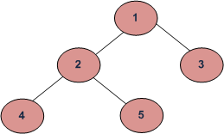
BFS and DFSs of above Tree
Breadth First Traversal : 1 2 3 4 5
Depth First Traversals:
Preorder Traversal : 1 2 4 5 3
Inorder Traversal : 4 2 5 1 3
Postorder Traversal : 4 5 2 3 1

Slide 15
Traversing
Traverse a tree means to visit all the nodes in some specified order.
There are three common ways to traverse a tree
Pre order
In order
Post order

Slide 16
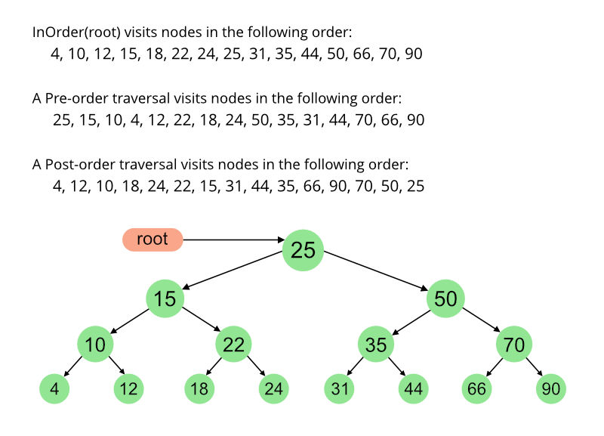

Slide 17
Inorder traversing
Call itself to traverse the node’s left subtree
Visit the node
Call itself to traverse the node’s right subtree

Slide 18
Inorder traversing cont…
50
13. Visit 50
1
18
14
16. Visit 60
7. Visit 30
30
60
12
2
6
8
15
17
20
40
10. Visit 40
3
5
9
11
4. Visit 20

Slide 19
Preorder traversing
Visit the node
Call itself to traverse the node’s left subtree
Call itself to traverse the node’s right subtree

Slide 20
Question 2
Write the output, if the following tree is traverse in preorder.
50
30
60
20
40

Slide 21
Postorder traversing
Call itself to traverse the node’s left subtree
Call itself to traverse the node’s right subtree
Visit the node

Slide 22
Question 3
Write the output, if the following tree is traverse in postorder.
50
30
60
20
40

Slide 23
Binary search tree - Implementation
Node Class
Node contains the information about
an object.
Each node should have
a key, data and
reference to left and
right child.
class Node
{
public int iData; // data item (used as key value)
public double dData; //other data
public Node leftChild; // this node’s left child
public Node rightChild; //this node’s right child
public void displayNode( ){
System.out.print(“{“);
System.out.print(iData);
System.out.print(”, “);
System.out.print(dData);
System.out.print( “ } ”);
}
}

Slide 24
Binary search tree - Implementation
Tree Class
class Tree
{
private Node root; // first node of tree
public Tree(){
root = null;
}
public void insert (int id, double dd){
}
public boolean delete (int id){
}
public Node find (int key){
}
}

Slide 25
Binary search tree - Implementation
class Tree
{
private Node root;
public Tree(){
root = null;
}
public void insert (int id, double dd){
}
public void delete (int id){
}
public Node find(int key){
Node current = root;
while (current.iData != key)
{
if(key < current.iData)
current = current.leftChild;
else
current = current.rightChild;
if (current == null)
return null;
}
return current;
}
Tree Class – Find Method

Slide 26
Binary search tree - Implementation
class Tree{
private Node root;
……….
……….
public void insert ( int id , double dd){
Node newNode = new Node();
newNode.iData = id;
newNode.dData = dd;
if (root == null) // no node in root
root = newNode;
else // root occupied
{
Node current = root; //start at root
Node parent;
while (true)
{
parent = current;
if (id < current.iData) // go left
{
current = current.leftChild;
if (current == null) {
parent.leftChild = newNode;
return;
}
}
else // go right
{
current = current.rightChild;
if (current == null){
parent.rightChild = newNode;
return;
}
}
}
}
}
Tree Class – Insert Method

Slide 27
Binary search tree - Implementation
Tree Class – Inorder Traversing Method
private void inOrder(Node localRoot)
{
if (localRoot != null)
{
inOrder(localRoot.leftChild);
localRoot.displayNode();
inOrder(localRoot.rightChild);
}
}

Slide 28
Binary search tree - Implementation
Tree Class – Preorder Traversing Method
private void preOrder(Node localRoot)
{
if (localRoot != null)
{
localRoot.displayNode();
preOrder(localRoot.leftChild);
preorder(localRoot.rightChild);
}
}

Slide 29
Binary search tree - Implementation
Tree Class – Postorder Traversing Method
private void postOrder(Node localRoot)
{
if (localRoot != null)
{
postOrder(localRoot.leftChild);
postOrder(localRoot.rightChild);
localRoot.displayNode();
}
}

Slide 30
Operations - Delete
First find the node to be deleted.
If the node to be deleted is found there are three cases to be considered. Whether
The node to be deleted is a leaf
The node to be deleted has one child
The node to be deleted has two children.

Slide 31
Case 1 : The node to be deleted has no children
Delete 7
10
10
5
5
3
7
3
null
Awaiting garbage collection
7
a) Before deletion
b) After deletion

Slide 32
Case 2 : The node to be deleted has one child
80
80
52
To be deleted
52
48
71
48
63
63
67
67
b) After deletion
a) Before deletion

Slide 33
Case 3 : The node to be deleted has two children
50
50
To be deleted
25
30
Successor
15
35
15
35
5
20
30
40
5
20
40
Successor to 25
a) Before deletion
b) After deletion

Slide 34
How to find a successor of a node?
In a Binary Search Tree, successor of a node is a node with next-highest key.
38
Go to right child
To find successor of this node
26
72
Go to left child
55
90
Go to left child
41
60
78
92
Successor
No left child
43
74

Slide 35
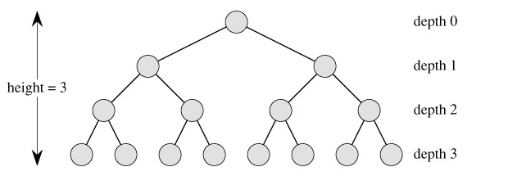
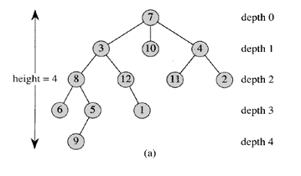
Tree Terminology
Degree of a node: The number of children it has
Depth: The depth of x in a tree is the length of the path from the root to a node x.
Height: The largest depth of any node in a tree.

Slide 36
Full Binary Tree
A Full binary tree of height h that contains exactly 2^{h+1}-1 nodes
Height, h = 2, nodes = 2²⁺¹-1= 7

Slide 37
Complete Binary Tree
It is a Binary tree where each node is either a leaf or has degree ≤ 2.
Completely filled, except possibly for the bottom level
Each level is filled from left to right
All nodes at the lowest level are as far to the left as possible
Full binary tree is also a complete binary tree

Slide 38
Question
Find Complete Binary Trees
2
3
4
5
6

Slide 39
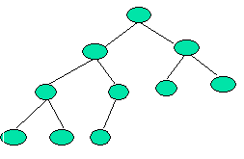
Height of a complete binary tree
Height of a complete binary tree that contains n elements is ⎣log₂(n)⎦
Example
Above is a Complete Binary Tree with height = 3
No of nodes: n = 10
Height = ⎣log₂(n)⎦ = ⎣log₂(10)⎦ = 3

